Slide 1
E-Process Serving

Slide 2
Idea behind the establishment:
Advancement of technology
An effective method
Monitoring tool
To improve the performance

Slide 3
Workflow
Court issuing electronic + documented process
PS Agency
Marking of process to relevant PS/Bailiff
Submission of documented + electronic report to Agency
Annexed documented + electronic report will be submitted to concerned court

Slide 4
Demonstration of Workflow
System consists of one web- based application and one android-based application
Web-based application consists of 3 modules
1. E-Ps MUHARRAR
Web based application will be used by Muharrars of all courts to input data of different processes issued from Courts along with scanned copy of documented process. Input data from courts will be marked to PS Agency.

Slide 5
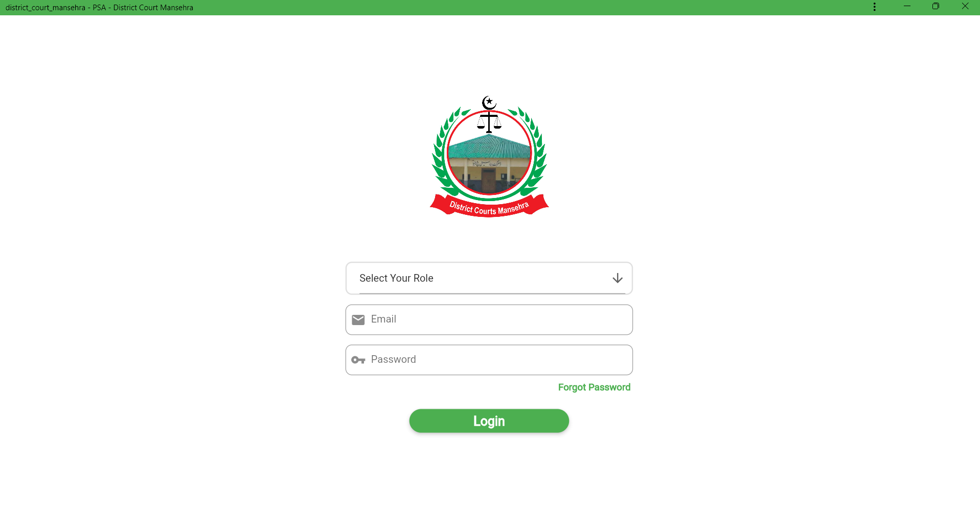

Slide 6
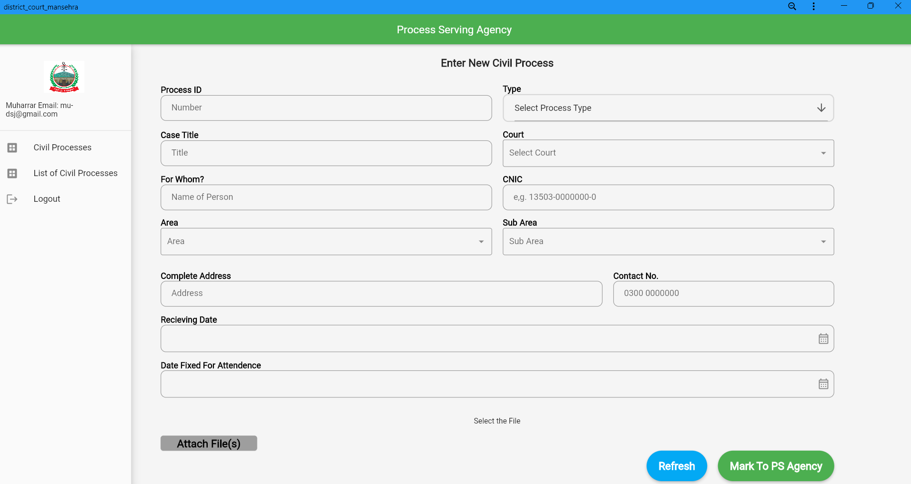

Slide 7
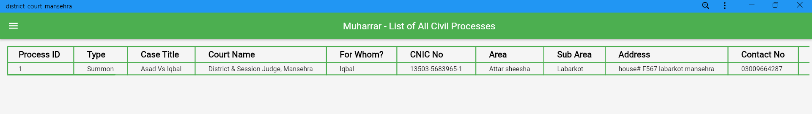
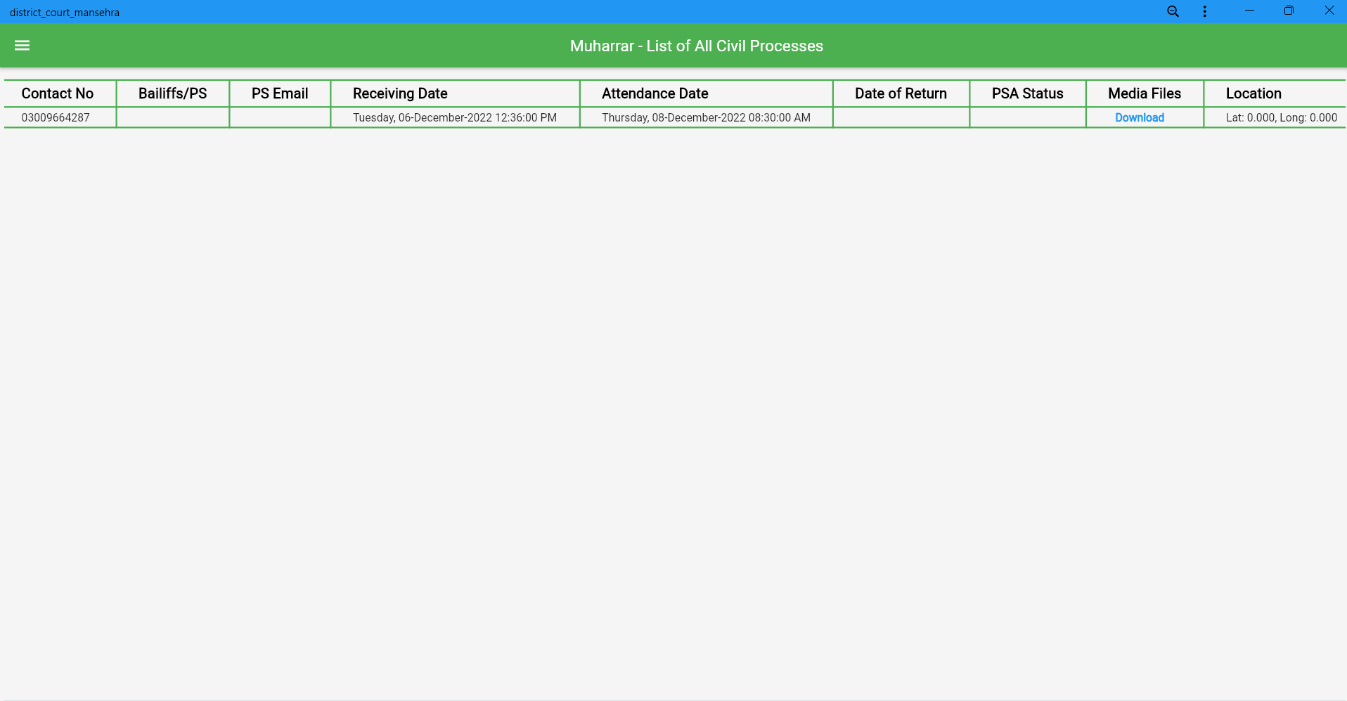
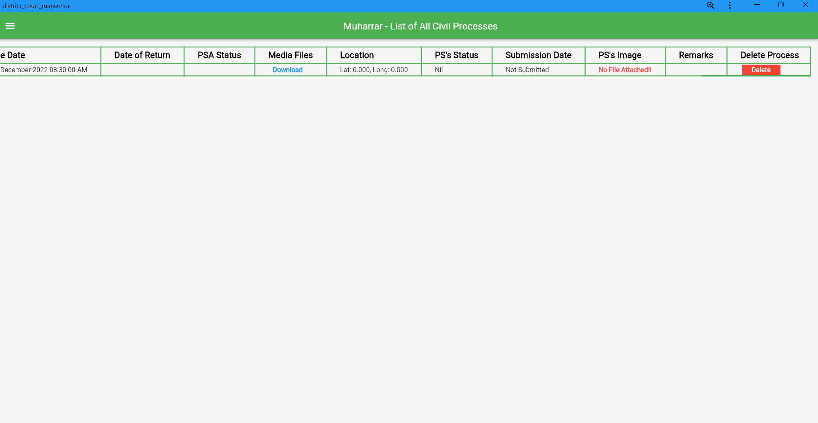
Before Service

Slide 8
2. E-Ps ADMINISTRATOR/NAIB NAZIR
Naib Nazir will mark that processes to relevant Bailiff or Process server dealing in those specific geographic areas. It will also collect and retrieve data submitted by Bailiff or Process servers. On complete execution of each process, Naib Nazir will transmit report to concerned court.

Slide 9
FEATURES OF WEBSITE:
Monthly progress report generation
Custom details entry of Areas and PS/Bailiff
Secure access to confidential data
High-court module (electronic entry and dispatch register)

Slide 10
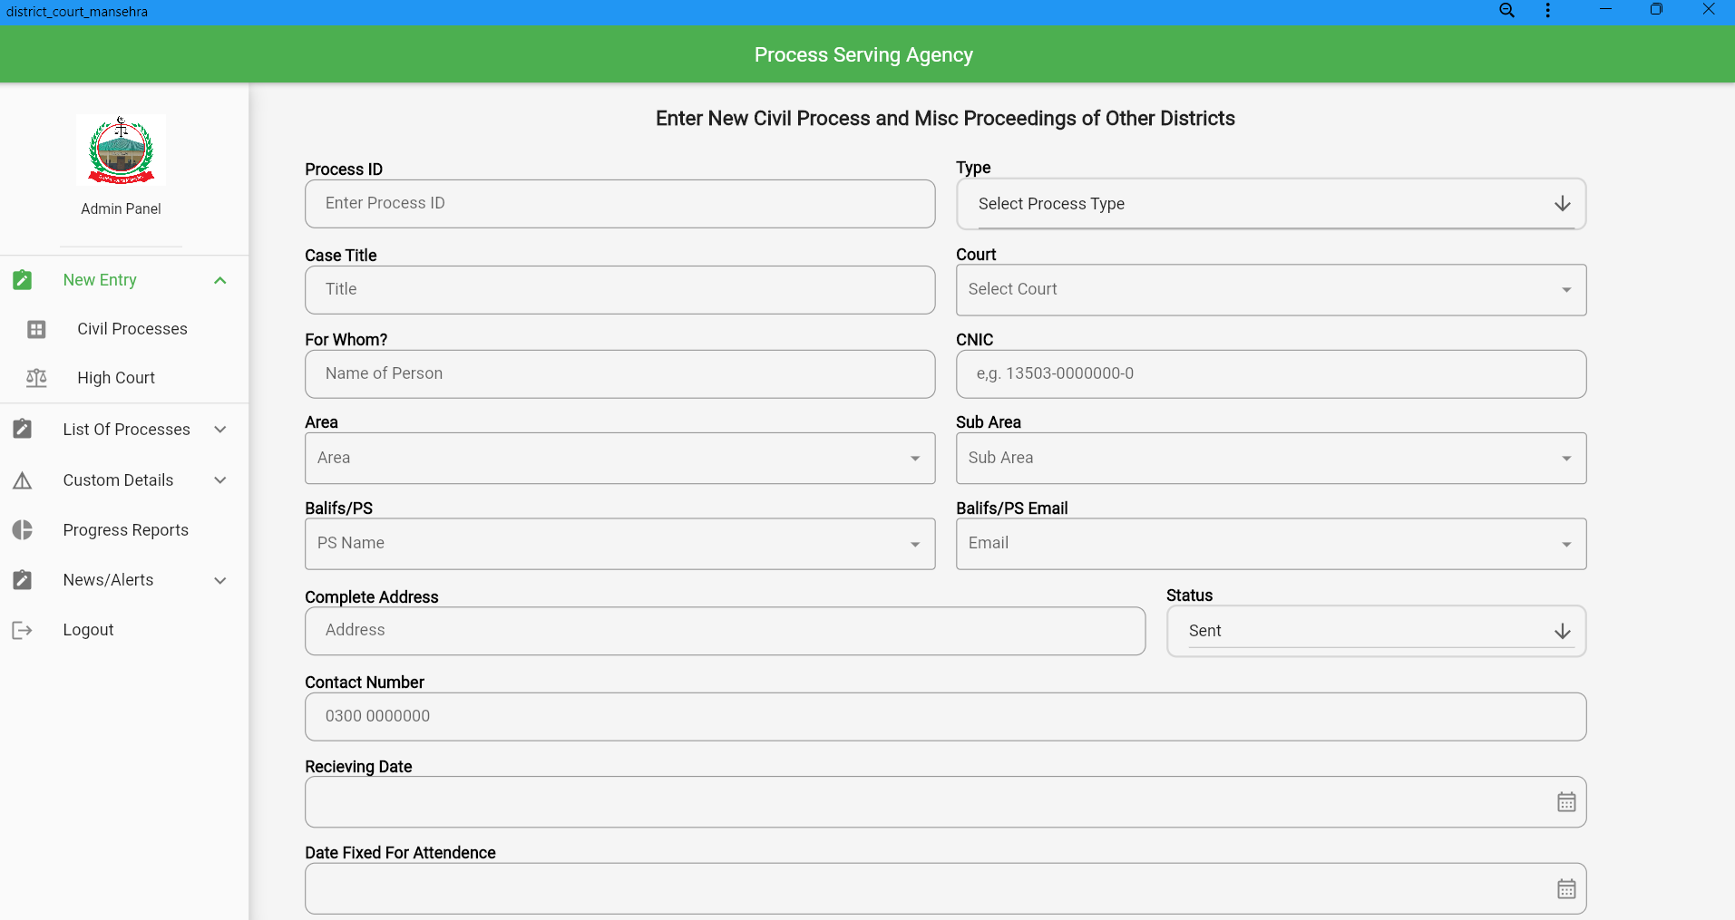

Slide 11
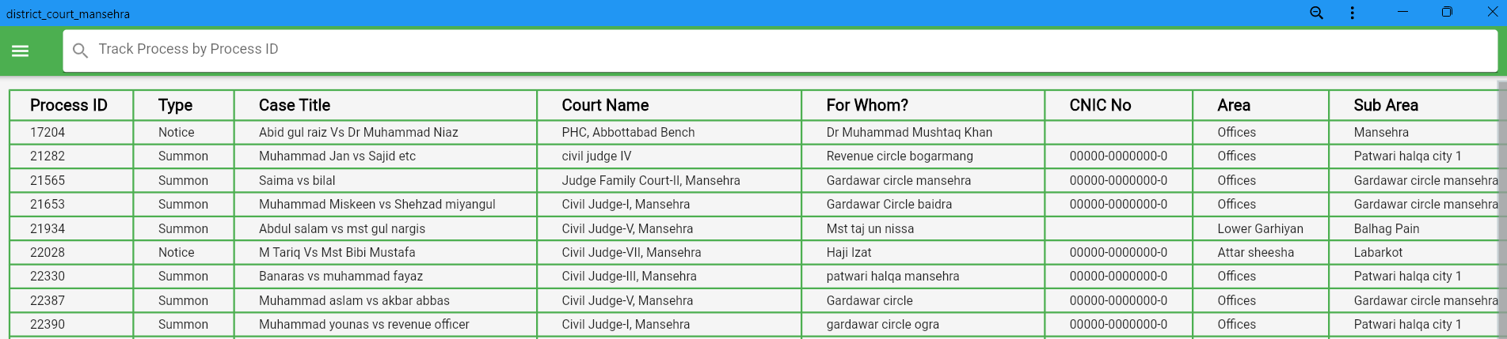
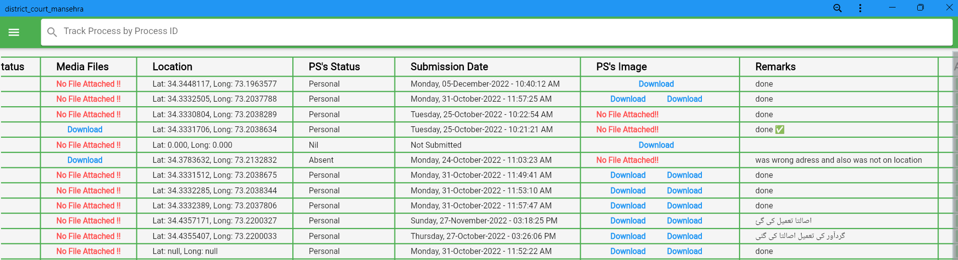

Slide 12
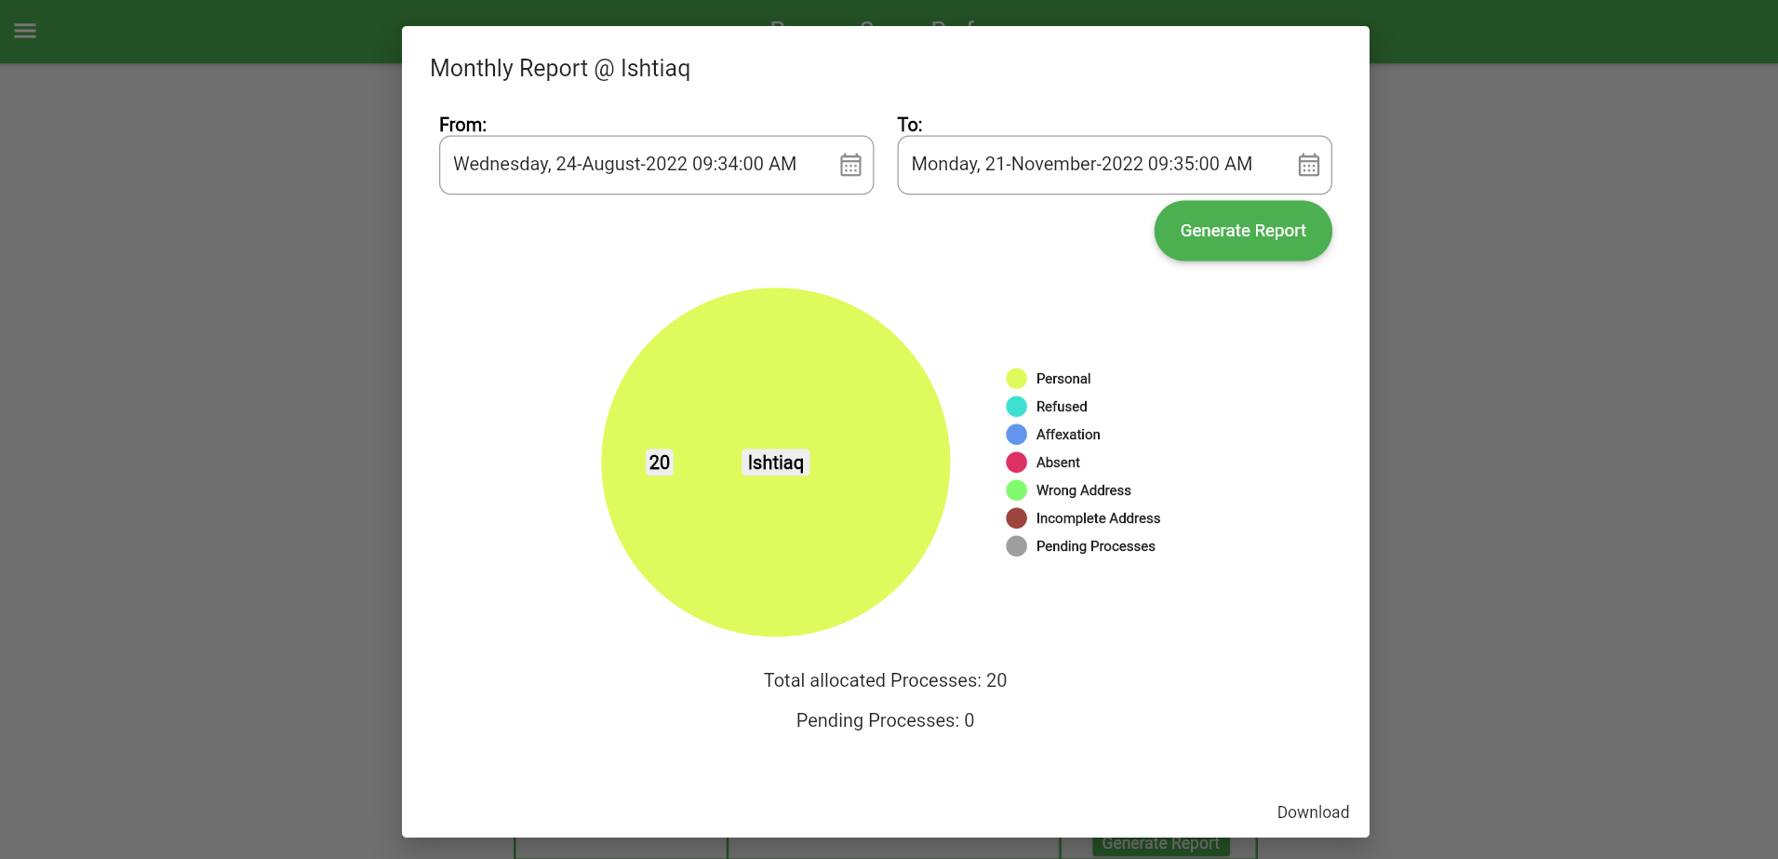

Slide 13
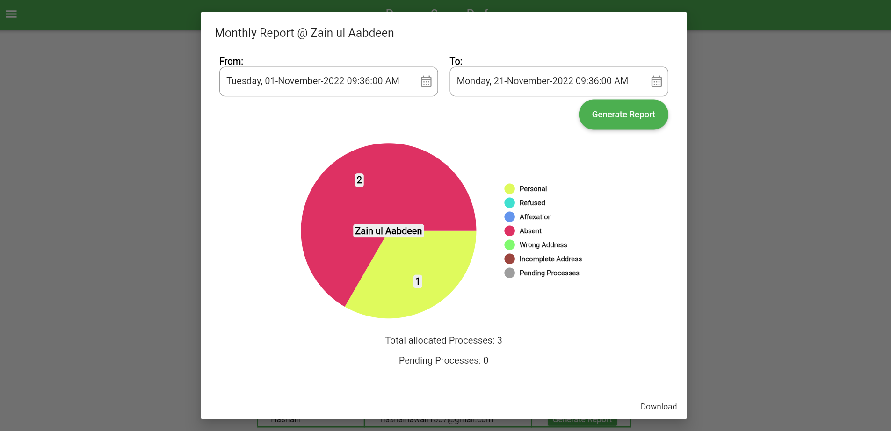

Slide 14
Android- based Application
Process server or Bailiff will login into the application and receives processes assigned by PS Agency. In order to ensure the presence and visit of the Process Server to the respective address, A GPS tracker will be installed to automatically track its location (longitude and latitude). The current date, time, status, remarks, images, or any other proof of service of process will also be the part of information retrieved from Process servers.

Slide 15
FEATURES OF ANDROID APP:
Onetime login
Real Time Reporting
Global Positioning System GPS
Image + Video uploading
Limited and Defined Roles and Privileges

Slide 16
طریقہ استعمال براَءے پیادگان و بیلفان
موبائل میں سمن کی الیکٹرانک انٹری جائے تعمیل پر ہی رہ کر کرنی ضروری ہے۔
تعمیل کے وقت مدعا علیہ کے ساتھ تصویر، یا پھر اسکی جگہ جو بھی ثمن وصول کرے گا اسکے ساتھ تصویر بنانا ضروری ہے جسے ثبوت کے طور پر ریکارڈ کا حصہ بنایا جائے گا۔
کیمرہ میں بنایئ جائے گی اور اسے سمن کی الیکٹرانک انٹری کے وقت Timestamp enterpriseتصویر صرف
اپلوڈ کرنا ضروری ہے۔
حوالگی قبضہ میں جس جگہ پر مثنٰے وارنٹ چسپاں کیا جائے گا اس جگہ کی تصویر اور جائیداد کی وڈیو بنانا ضروری ہے۔

Slide 17
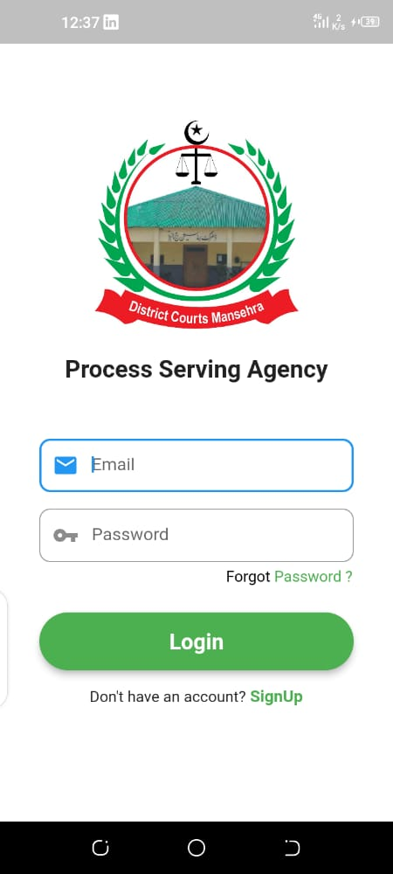
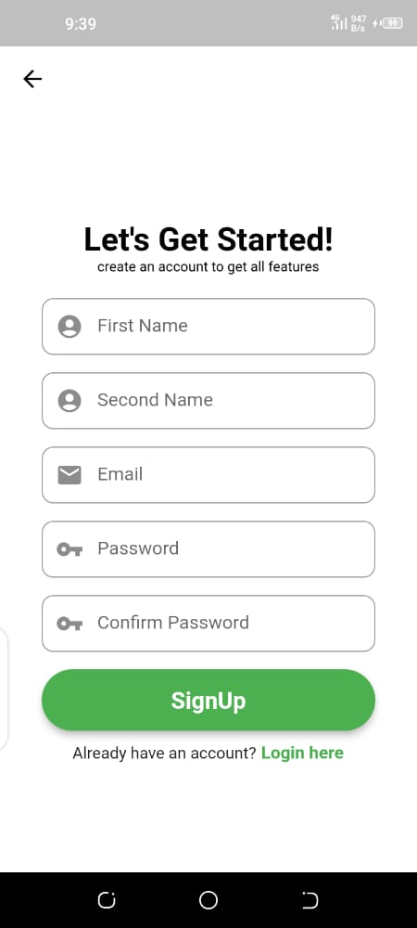
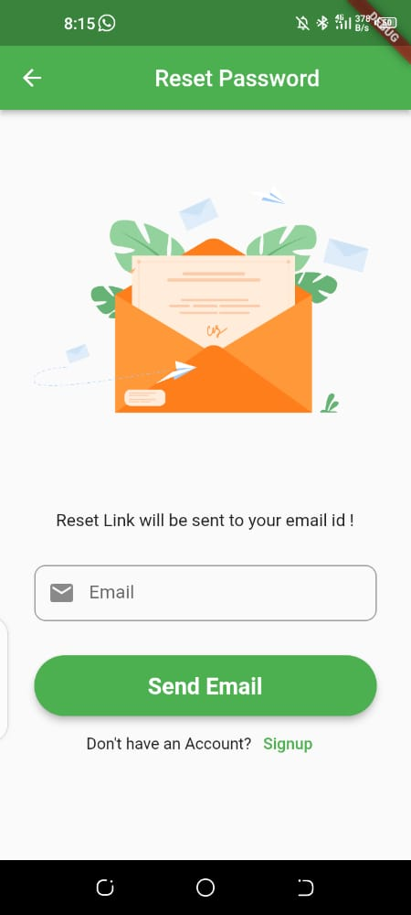

Slide 18
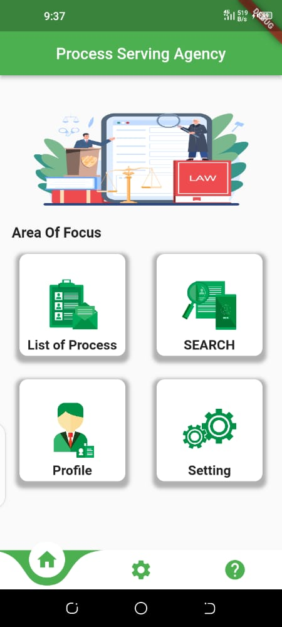
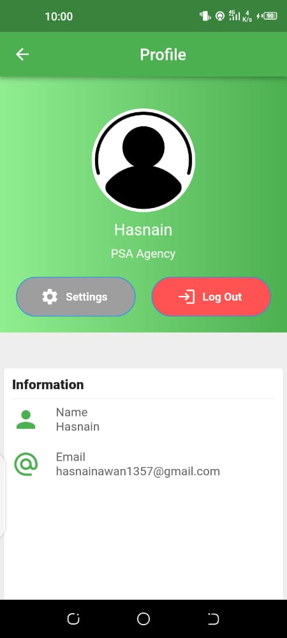
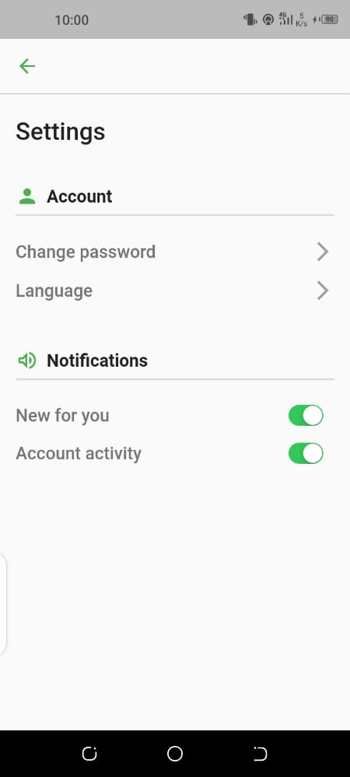

Slide 19
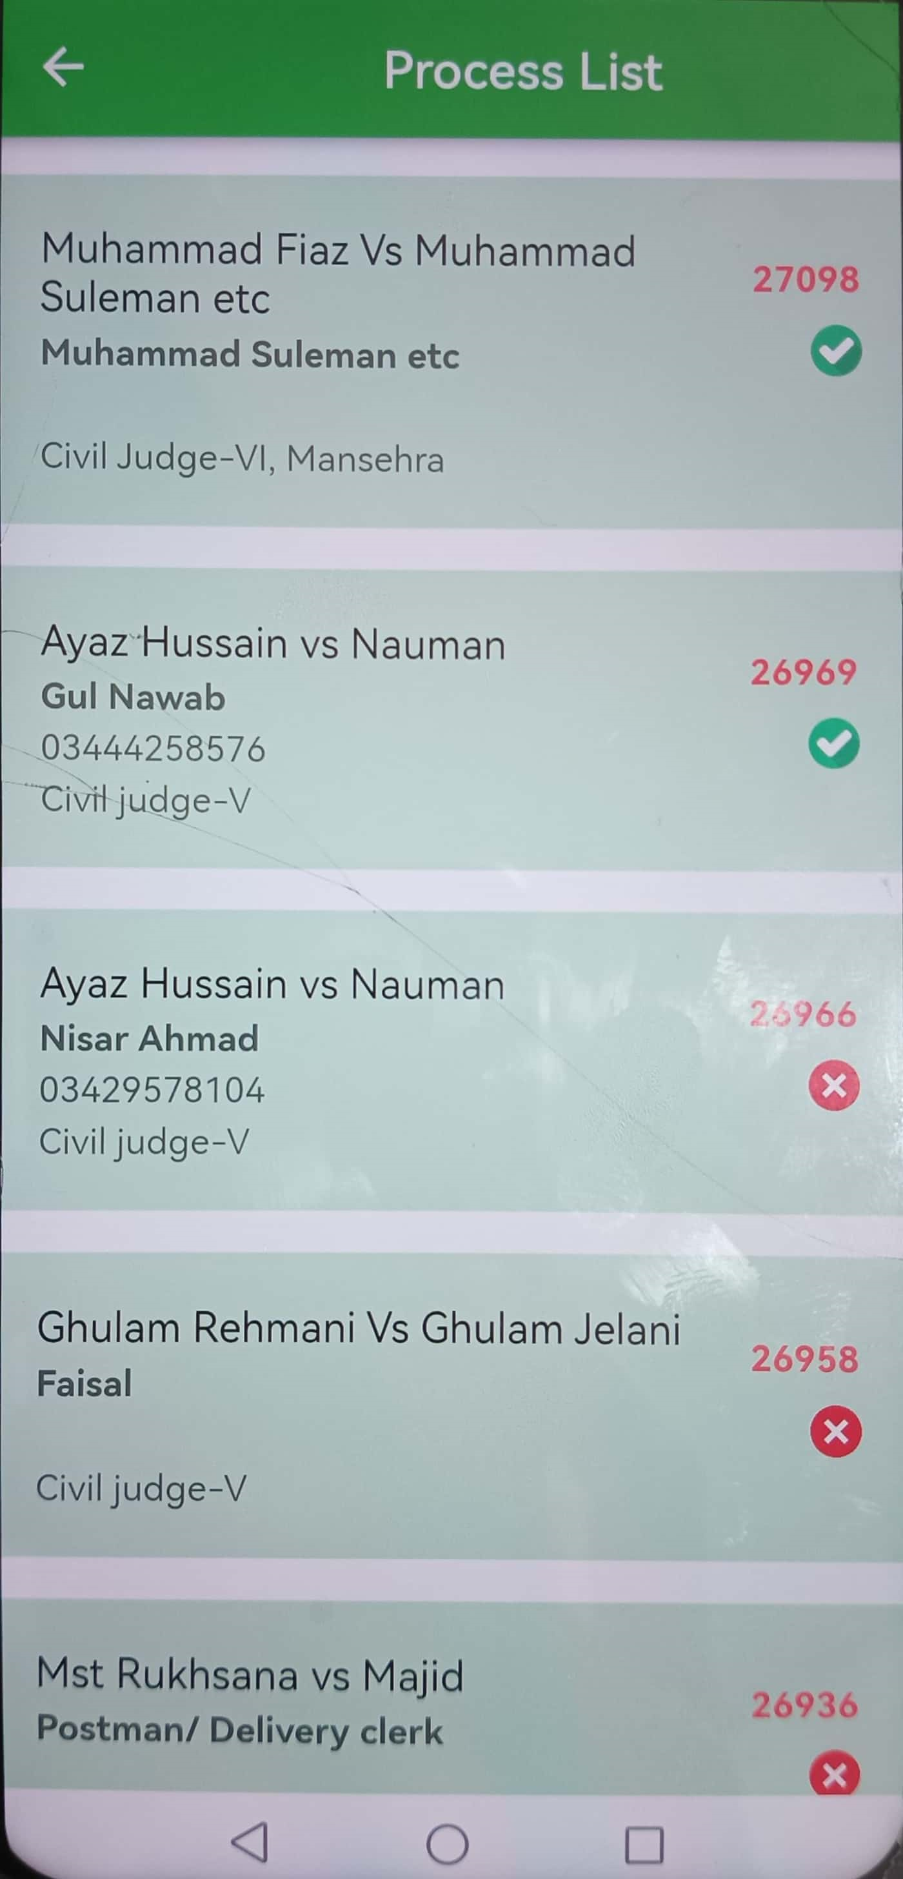

Slide 20
Not Served Yet

Slide 21
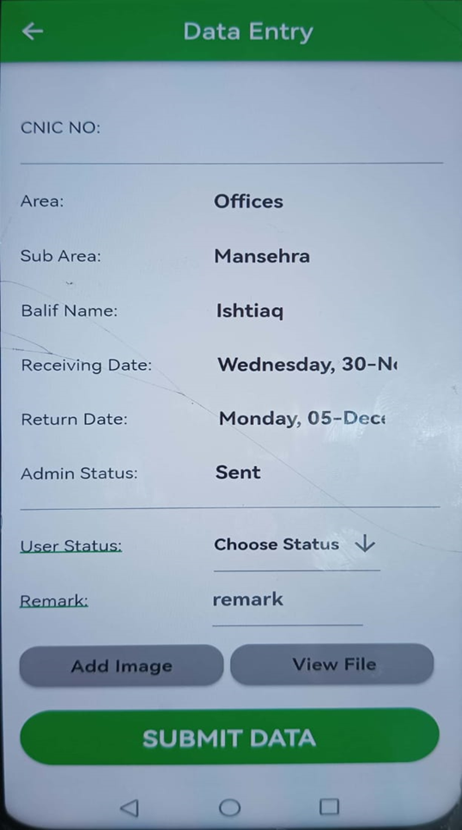

Slide 23
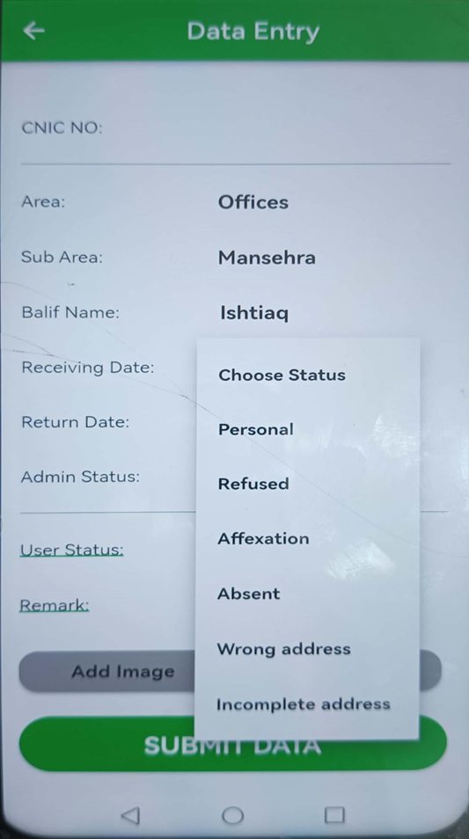

Slide 24
اصالتاً تعمیل

Slide 25
انکاری

Slide 26
چسپانگی

Slide 27
غیر حاضر

Slide 28
غلط پتہ

Slide 29
نامکمل پتہ

Slide 30


Slide 31
Opens up gallery of mobile phone

Slide 32
Can view attached documented process

Slide 33
After clicking this button not only submits your attached data but also submit your exact location, date, and time

Slide 34
After Service

Slide 35
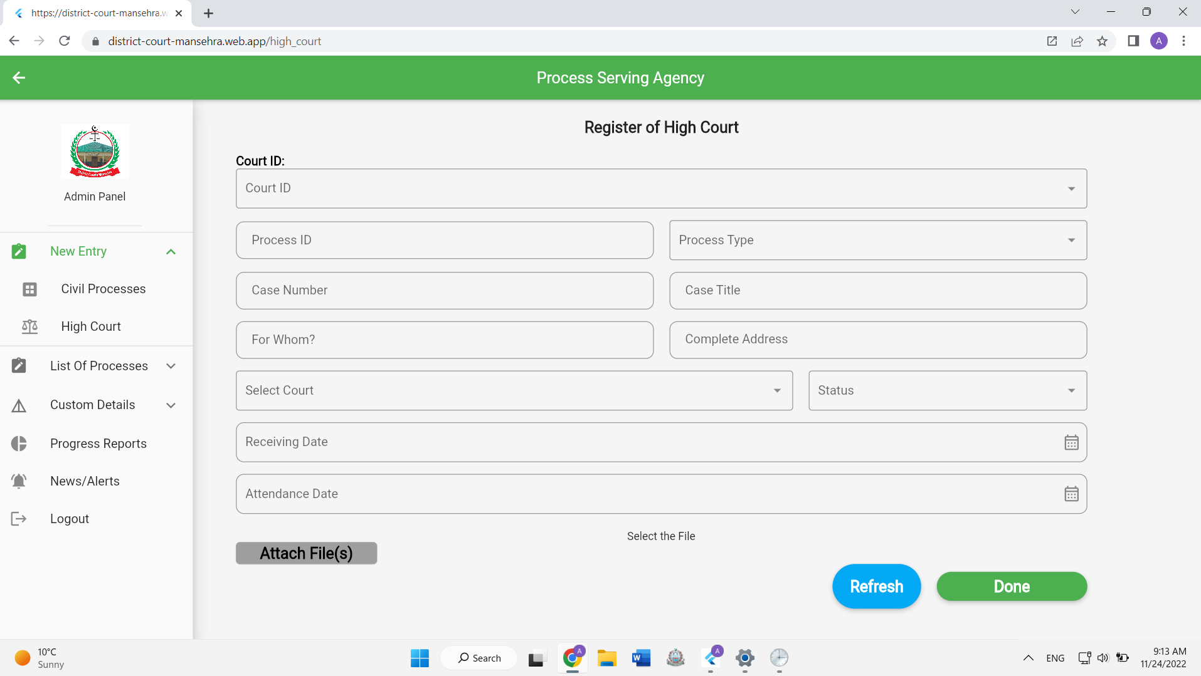
3. High Court Module

Slide 36
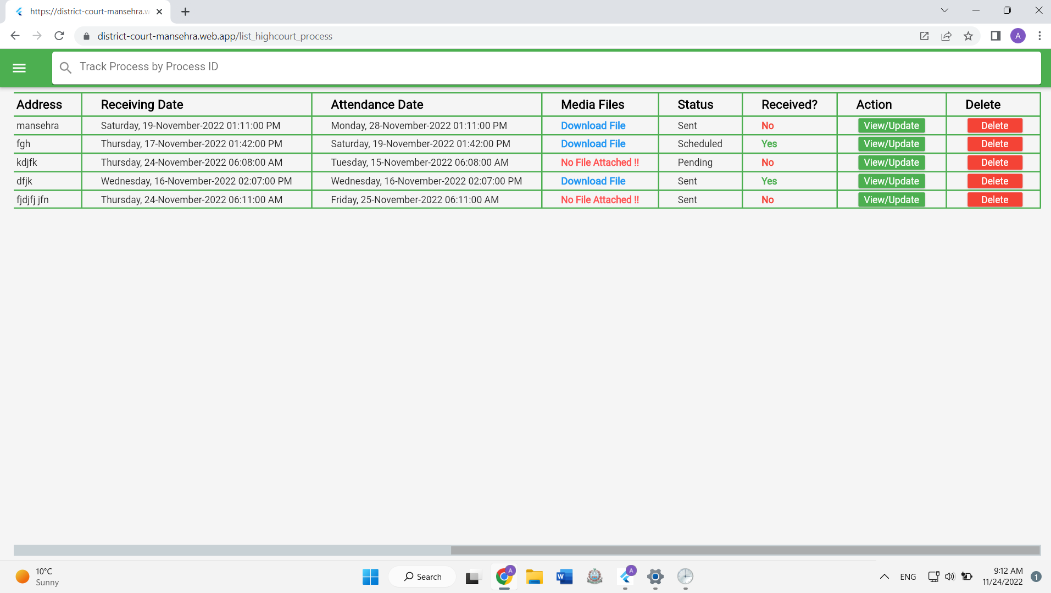

Slide 37
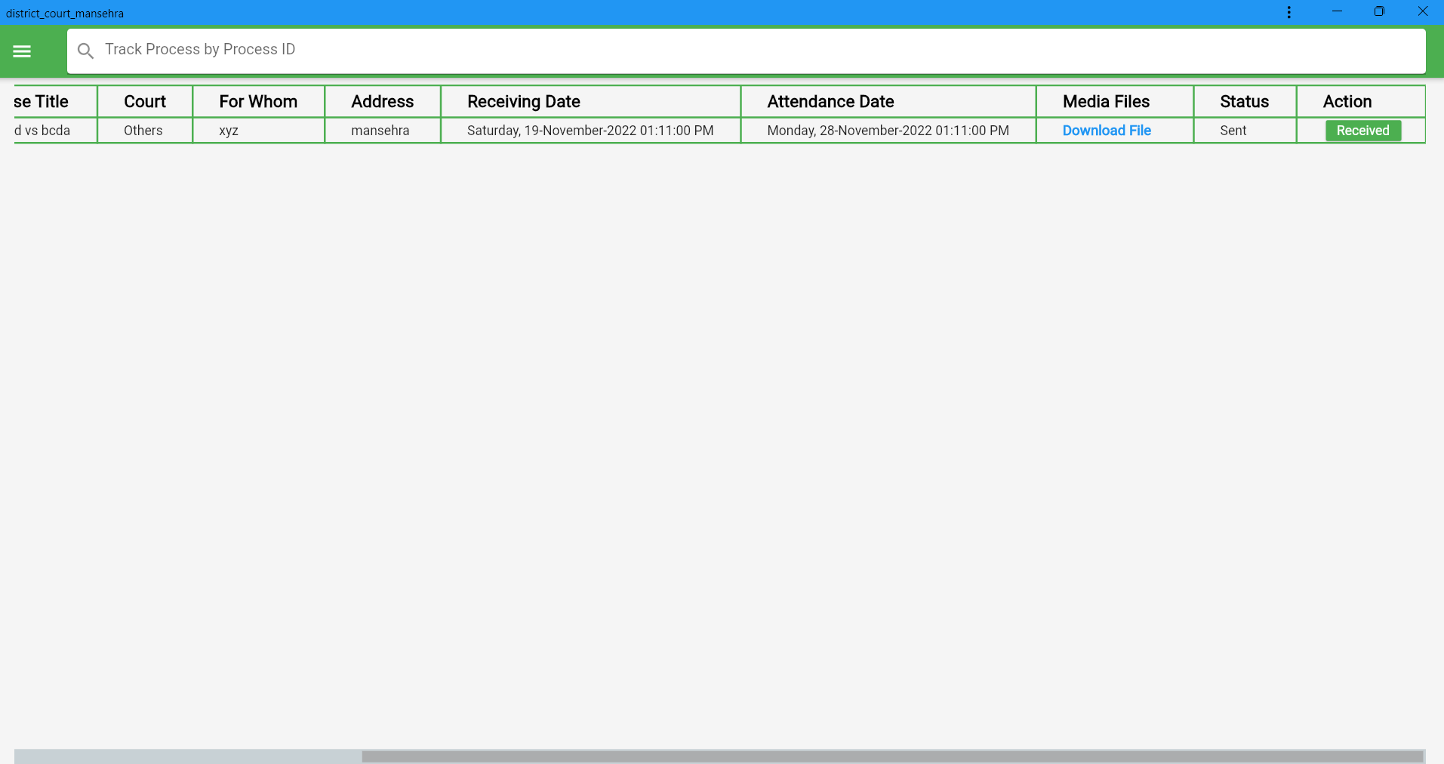

Slide 38
LEGAL REFERENCES
Civil Procedure Code Amendments 2020 Section 27 A sub section 2(b) allowed the service of court process with the help of electronic devices.
Civil Procedure Code Amendments 2020 Section 27 A sub section 5 allowed us to monitor the location of process server by modern devices.
Order V Rule 1 CPC 1908

